Slide 1



2026 KS2 SATs
Family Information Evening.
Welcome to the SATS Information Evening
What will you find out about tonight?
  What are SATs and why do we have them?
  What do the SATs assess?
  What SATs will my child be taking?
  When will my child and I find out their results?
  What are Potton Primary School doing to support my child?
  What could I do at home to support my child?
  How can I support my child in Maths, Reading and Grammar?
The KS2 SATs take place the week beginning:
Monday 11th May 2026

Slide 2
  What’s the point?
According to the experts, SATs aren’t about passing or failing, but are used to reflect the level your child is working at.
SATs shouldn’t be seen as a one-off period in the school calendar but as a part of the overall teaching your child receives throughout their education.

Slide 3
  What do the SATs assess?
In essence, SATs help schools – and you – learn more about your child's strengths and weaknesses.
Schools and parents gain an understanding of what children have learned during KS2 and how they can compare to their peers in school and across the country.
They can also measure how much each child improves from one Key Stage to another.

Slide 4
  What SATs will my child be sitting?
Test | Date
English Grammar, Punctuation and Spelling Paper 1: Short Answer Questions (45 minutes) Paper 2: Spelling (15 minutes) | Monday 11th May
English Reading Reading comprehension (60 minutes) | Tuesday 12th May
Mathematics Paper 1: Arithmetic (30 minutes) Paper 2: Reasoning (40 minutes) | Wednesday 13th May
Mathematics Paper 3: Reasoning (40 minutes) | Thursday 14th May

Slide 5
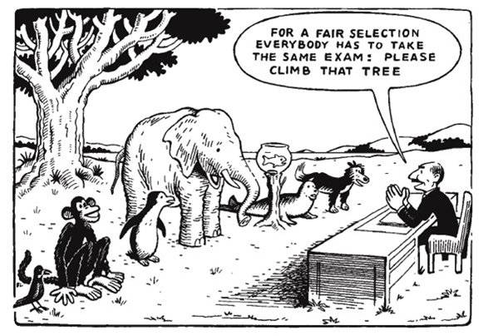
  Access Arrangements
The majority of pupils will sit the tests in their usual classroom with their class teacher and another adult.
Some children may be entitled to some additional arrangements including:
25% extra time
A scribe
Movement breaks
Some children may also work in a ‘quiet work space’ which means they’ll be in a room with fewer children.
Notes:
Already discussed, most likely.

Slide 6
  The Results
‘Old’ national curriculum levels (e.g. Level 3, 4, 5) have been abolished for some time now. Instead, test scores are now reported as ‘scaled scores’. Each child’s raw test score is converted into a score on the scale, either at, above or below 100.
In July, each pupil will receive:
A raw score (number of raw marks awarded).
A scaled score in each tested subject.
Confirmation of whether or not they attained the national standard.

Slide 7
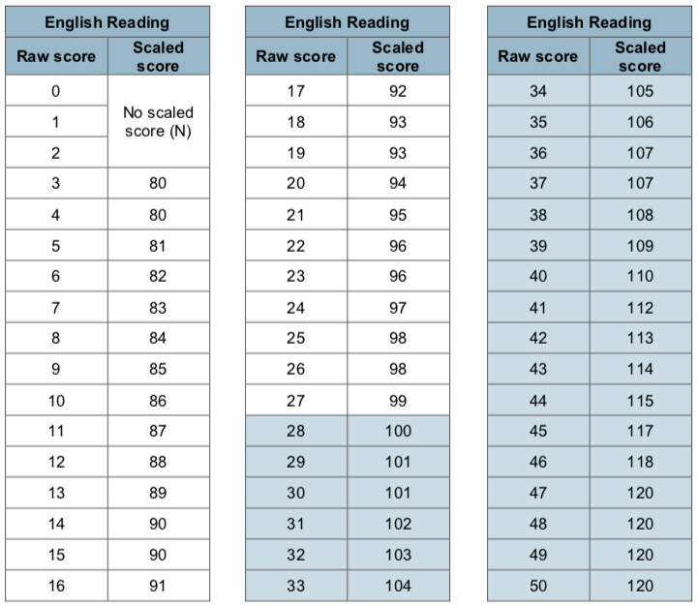
Scaled Score Examples
On publication of the test results in July 2026:
A child awarded a scaled score of 100 or more will be judged to have met the ‘national standard’ in the area judged by the test.
A child awarded a scaled score of less than 100 is judged to have not yet met the national standard and performed below expectation for their age.
2019 scaled scores for English Reading

Slide 8
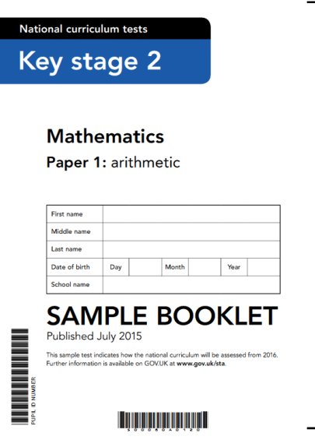
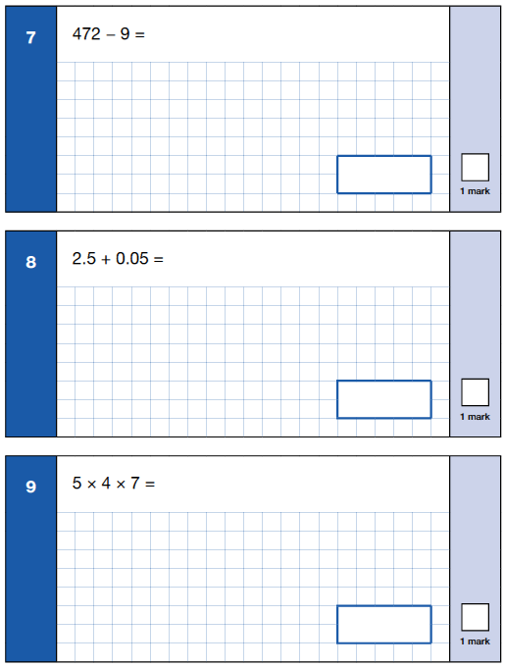
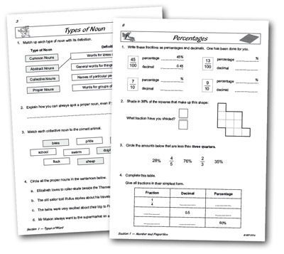
  What are doing to support my child?
In school, there are many things we are implementing to prepare the children for their assessments. These include actions that have been embedded from the beginning of KS2, all the way through to the moment they enter Year 6.
Weekly Arithmetic & Reasoning questions.
Daily GPS and Maths starter tasks taken from the Year 6 curriculum.
These tasks reinforce areas of GPS and Maths previously taught.
Notes:
Teaching
Targeted intervention
Regular revisiting of material
Starters in Maths and English
CGP books
Reading lots – echo reading and guided reading
Regular testing

Slide 9
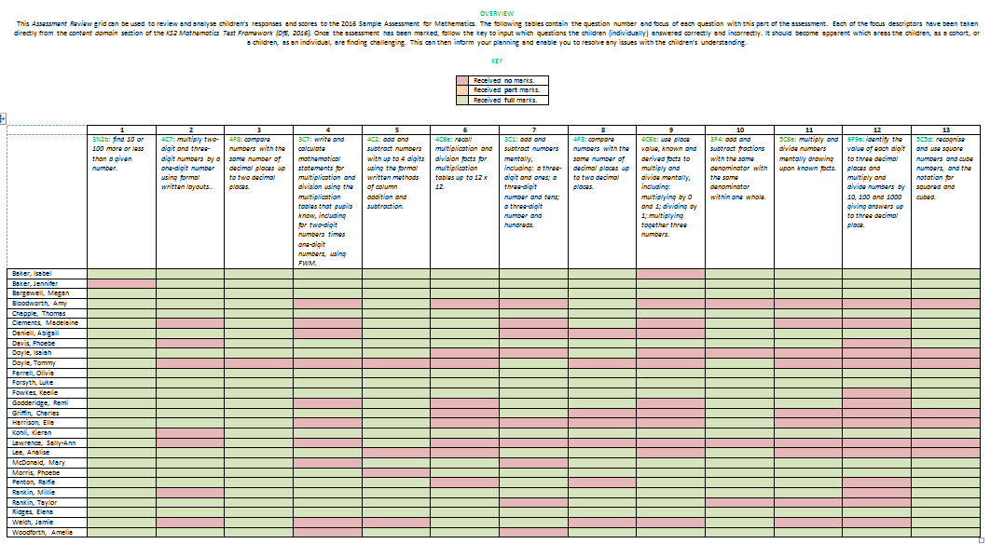
  What are doing to support my child?
Planning lessons based on assessment data and areas for required improvement.
Mock SATs weeks
Answers to assessment questions are analysed, as well as work in exercise books, to identify areas of improvement. These areas are then addressed in lessons.

Slide 10
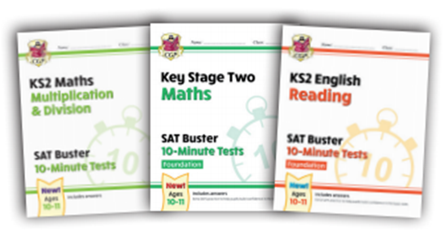
  What could I do at home to support my child?
'Real Life’ Maths questions or activities (such as cooking).
Spelling Practice
CGP revision guides and online quizzes

Slide 11
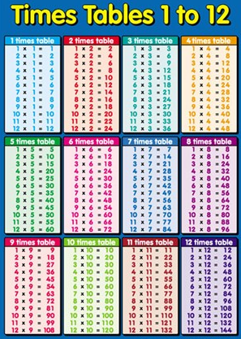

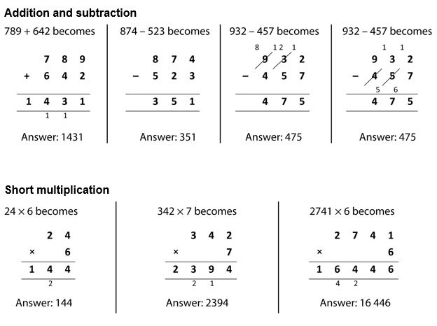
  What could I do at home to support my child?
Practice and rehearse multiplication and division facts up to 12 x 12.
Practice formal written methods for addition, subtraction, multiplication and division.
Read, read, read with your child!
Ask them to teach you!
Notes:
Outdoor learning

Slide 12
Mathematics
The 2026 Key Stage 2 mathematics national curriculum tests will consist of three separate test papers:
Paper 1: arithmetic [40 marks] - 30 mins
Paper 2: reasoning [35 marks] - 40 mins
Paper 3: reasoning [35 marks] - 40 mins
Questions gradually increase in difficulty. Not all children will be expected to access some of the more difficult questions later in the paper.
The 2026 Expected Standard was 54/110.

Slide 13
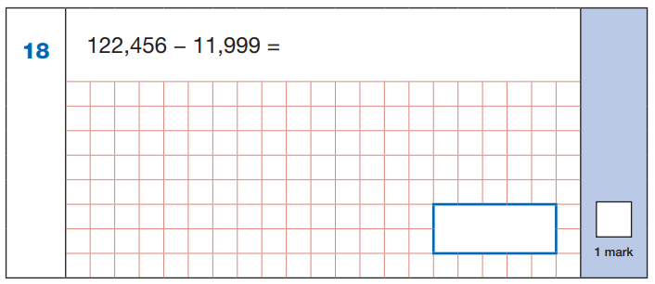
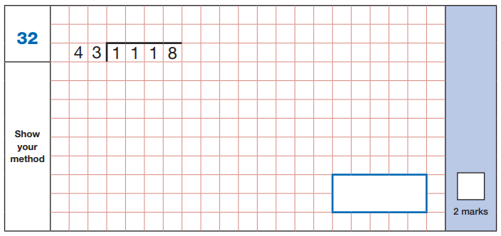
Arithmetic
The arithmetic paper consists solely of number calculations with no context. Pupils need to calculate efficiently and use a range of strategies, as they have only 30 minutes to solve 36 questions, with an expectation that formal methods will be used. The tests covers calculation methods for all operations, including use of fractions, percentages and decimals.

Slide 14
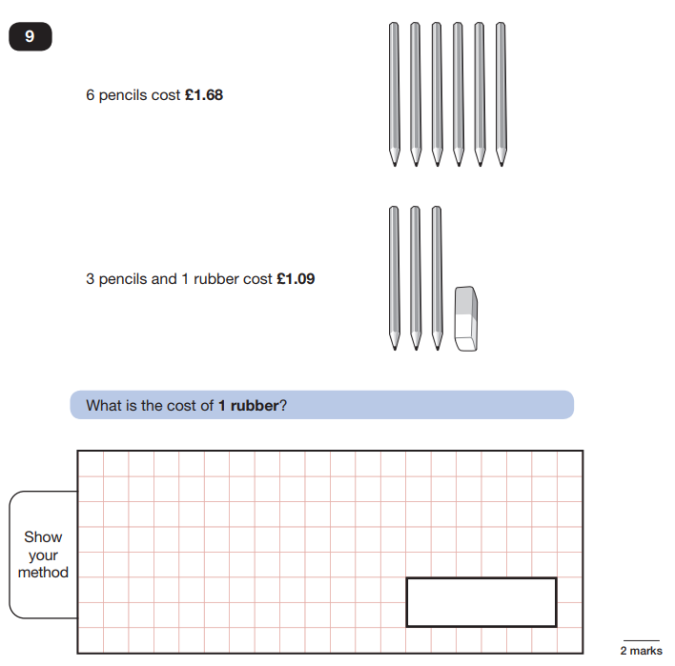
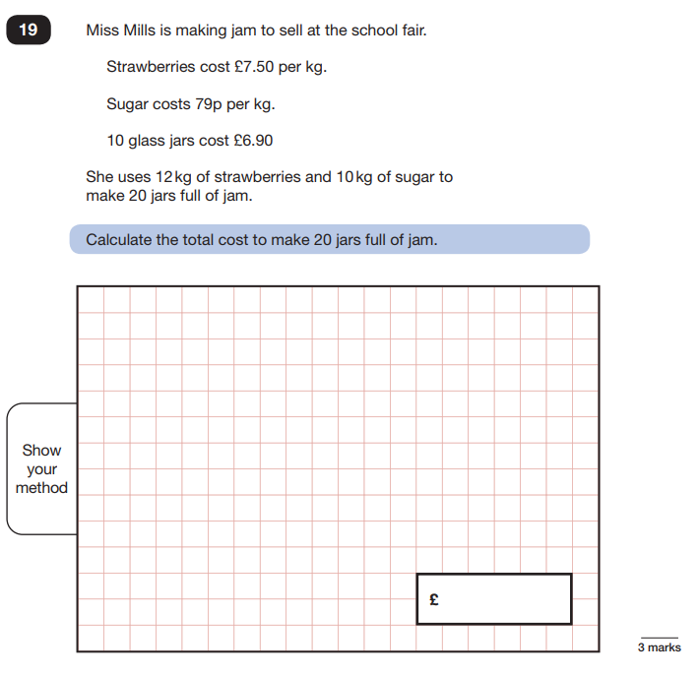
Reasoning
The two reasoning papers consist of a range of question types in and out of context. Pupils need to demonstrate understanding across the mathematics curriculum, although there is still a greater proportion of marks allocated to Number and Calculations. Papers 2 and 3 cover problem solving and reasoning, each lasting for 40 minutes. Pupils will still require calculation skills but will need to answer questions in context and decide what is required to find a solution.

Slide 15

How to Help Your Child with Maths
Play times tables games.
Play mental maths games including counting in different amounts, forwards and backwards.
Encourage opportunities for telling the time.
Encourage opportunities for counting coins and money; finding amounts or calculating change when shopping.
Look for numbers on street signs, car registrations and anywhere else!
Look for examples of 2D and 3D shapes around the home.
Identify, weigh or measure quantities and amounts in the kitchen or in recipes, scale up or scale down recipes.
Play games involving numbers or logic, such as dominoes, card games, darts, draughts and chess.

Slide 16
Grammar, Punctuation & Spelling
Question Paper (50 questions / 45 mins)
Spelling Test (20 spellings)
Last year’s expected standard: 35/70

Slide 17
Grammar, Punctuation & Spelling
What is being tested?
Word classes
Punctuation
Sentence structure
Verb form and tenses
Vocabulary
Standard English

Slide 18
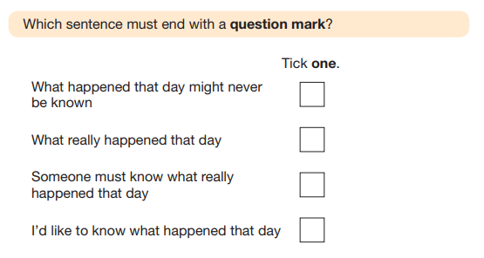
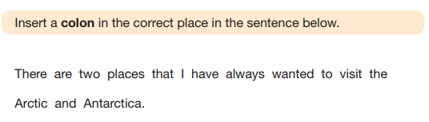

Slide 19
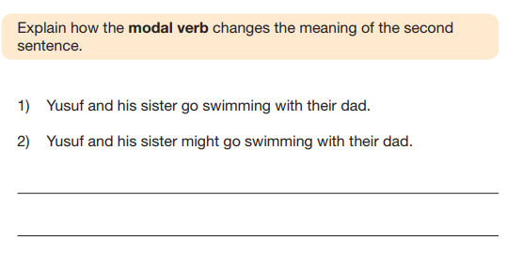
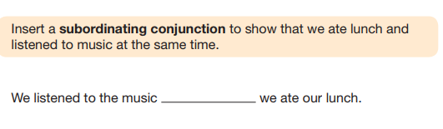

Slide 20
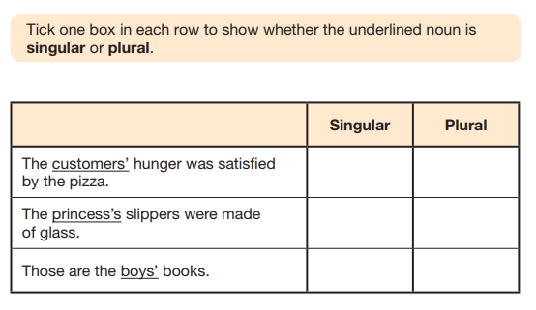
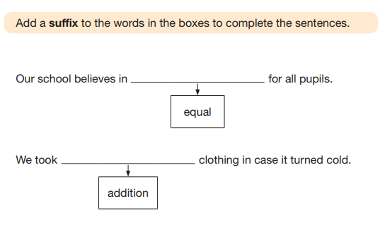

Slide 21
Grammar, Punctuation & Spelling
How can you support your child at home?
Revision guides
Past papers
Revision activities
Reading
Get them to teach you!

Slide 22
Reading
Reading paper (1 hour)
Three extracts
50 marks
Last year’s expected standard: 27/50

Slide 23
Reading
Question Type | % of 2017 paper
Vocabulary | 20%
Retrieval | 28%
Summary | 4%
Inference | 44%
Compare, Contrast & Comment | 2%
Author Choice | 2%

Slide 24
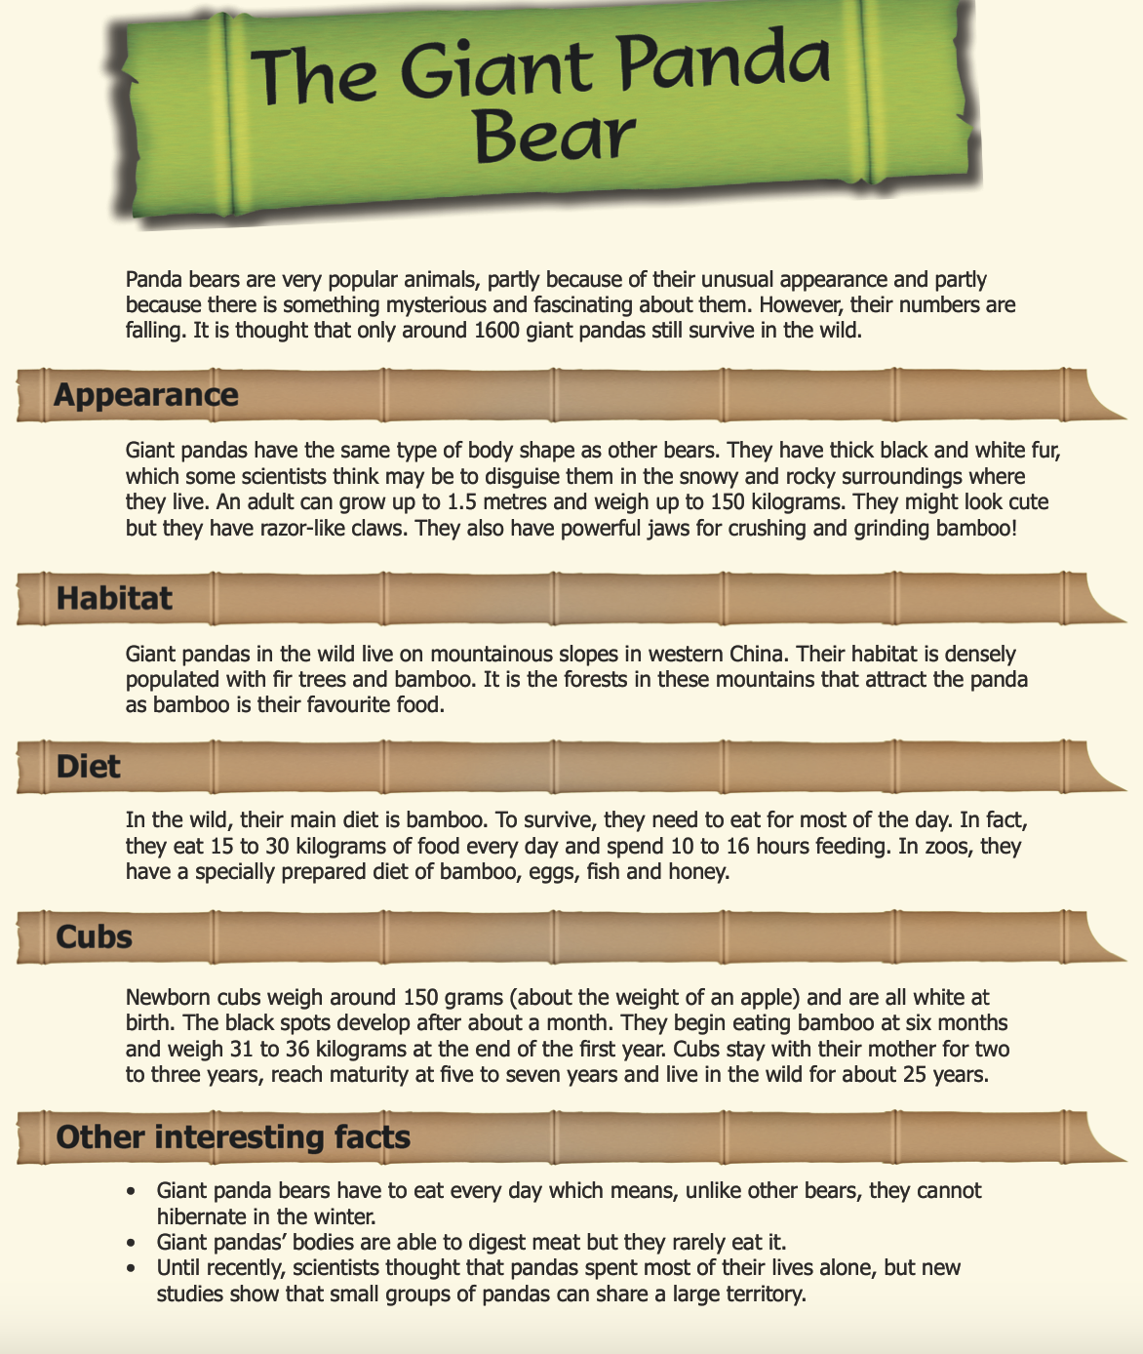
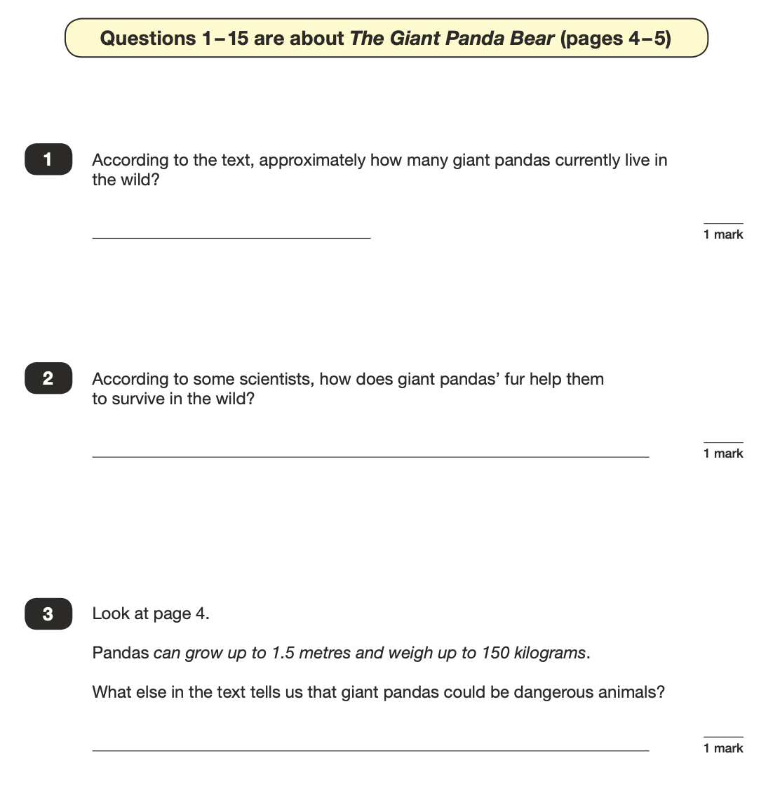

Slide 25
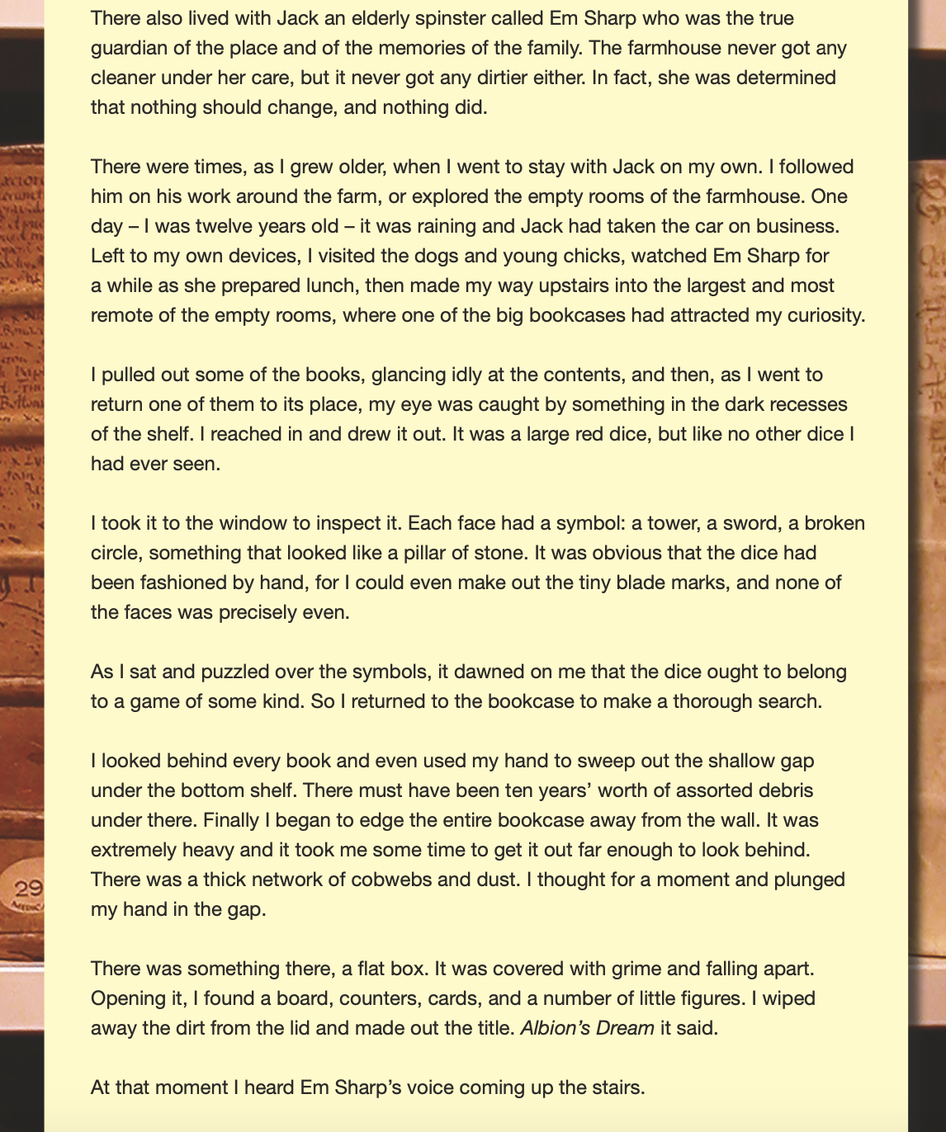
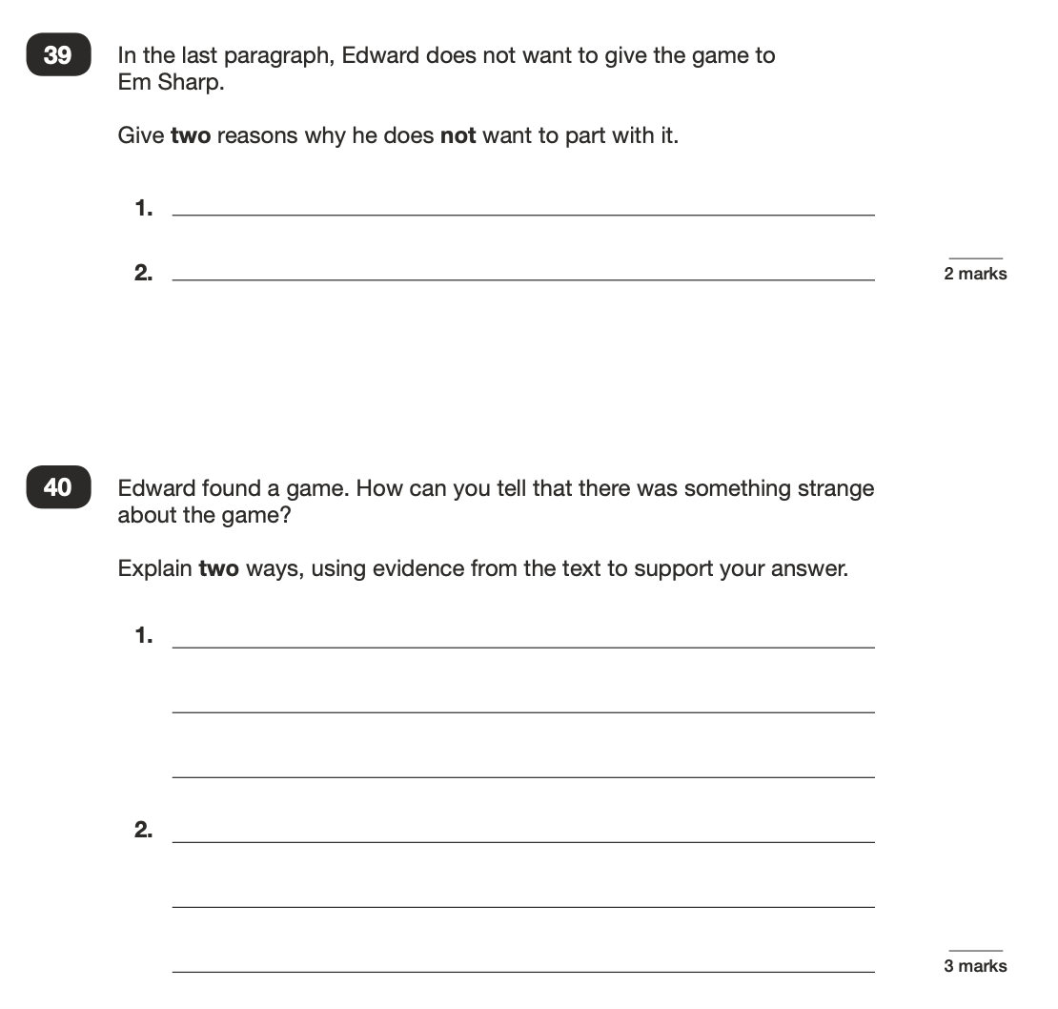

Slide 26
Reading
How can you support your child at home?
Vocabulary
Lots of talk and lots of reading.
Don’t be afraid to use more advanced vocabulary and to explain its meaning to your child.
Discuss the meanings of words they come across and talk about how we could use those words in different situations.

Slide 27
Reading
How can you support your child at home?
Retrieval
Talk about books you have shared together and ask questions about details from the text.
Encourage your child to focus on what the question is asking and ask them to find specific information from the text:
When did X happen?
Where was X when X happened?
How many X?
Who said X?
What did X do when X happened?

Slide 28
Reading
How can you support your child at home?
Inference
Talk about what you have been reading together and ask lots of questions that begin with ‘why’, ‘where’, ‘who’, ‘how’, ‘what’, ‘do you think….?’
Encourage your child to explain why they think something and to refer back to the story to find evidence to back up their ideas.
‘What impression do you get of…? And why?’

Slide 29
  What could I do at home to support my child?
In the build up to SATs:
Encourage healthy learning habits e.g. support the completion of homework and revision tasks (little and often is the most productive).
Create a revision timetable together and stick to it.
Use revision sites
Make use of revision text books
Ask us for additional resources ☺
During SATs week:
Not putting children under too much pressure.
Ensuring children arrive for school:
- in good time
- having had breakfast
- having gone to bed at a reasonable time

Slide 30
  Friday Fun Day!
To celebrate all our children’s hard work this year, we will use the last day of SATs week to have some fun!
This year we will be:
Giving the children a range of activities to choose from in the morning (art, sports, games etc.)
In the afternoon we will watch a film and relax - they deserve it!
Year 6 End of Year Celebration!
More details to come!

Slide 31


  Something we share with the children…

